Slide 1
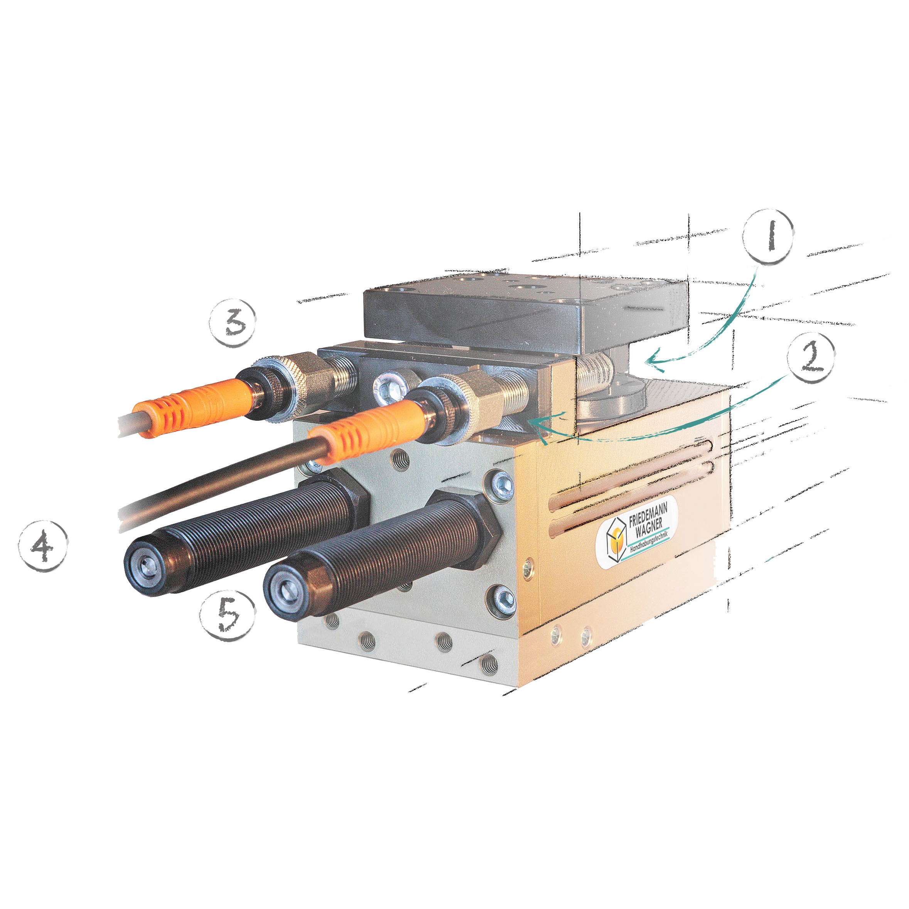
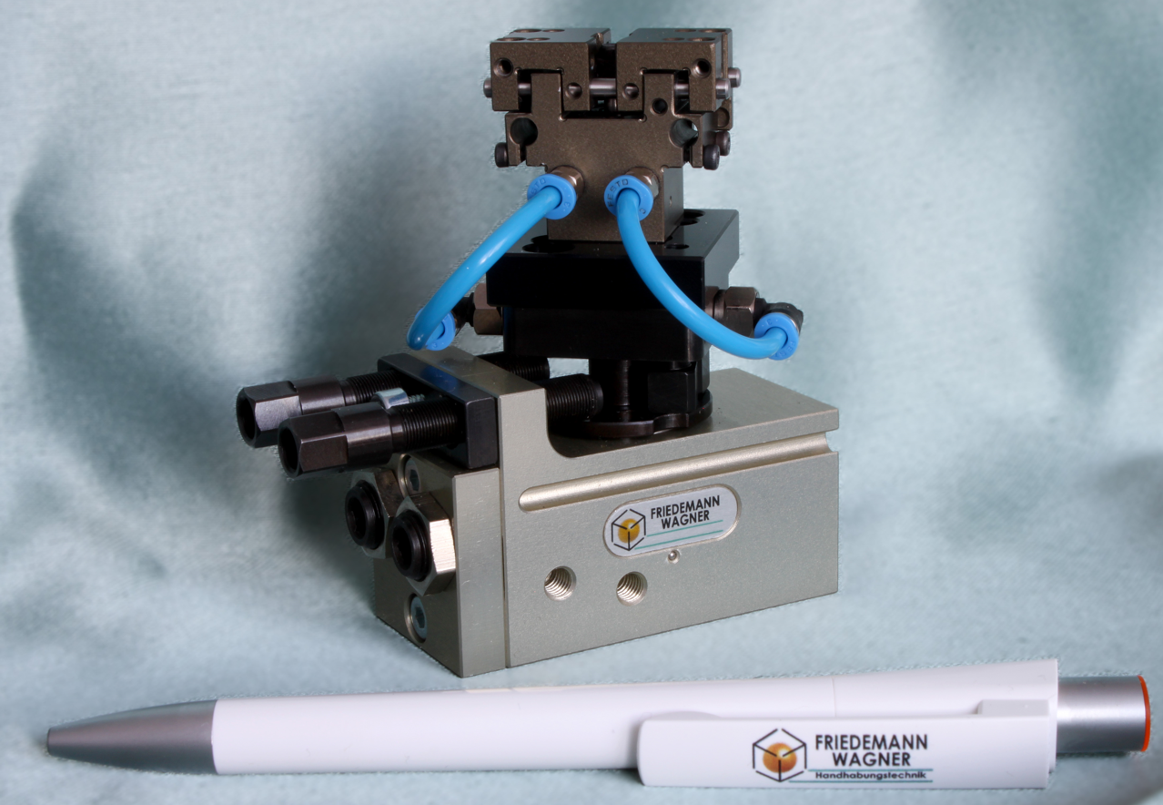
reproducible
benefits of pneumatic swivel-units of Wagner!
turning angle 0-190°
angle adjustable from outside
screw + stop-block = stop surface
external reproducable stop-positions
full torque in end-positions
stop-position independent from gear
+/- 0,01° repeat accuracy
…available as mini !
Friedemann Wagner GmbH | Robert-Bosch-Str. 5 | DE 78559 Gosheim | +49 (0)7426 94900 0

Slide 2
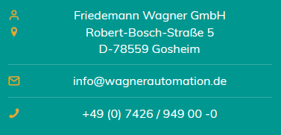
space-saving: sensor inside stop-screw
stop-screw + sensor are clamped via knurl
enables detection of shock-absorber-failure
dampers accessible from outside
ideal for adjustment and maintenance
damper only slows-down, stop is defined via screw!
interfering edges point to only one side
air-grommets in rotating shafts available
signal-grommets available ≥ SES-6
link technical animation
Friedemann Wagner GmbH | Robert-Bosch-Str. 5 | DE 78559 Gosheim | +49 (0)7426 94900 0
link to brochure

